Slide 1
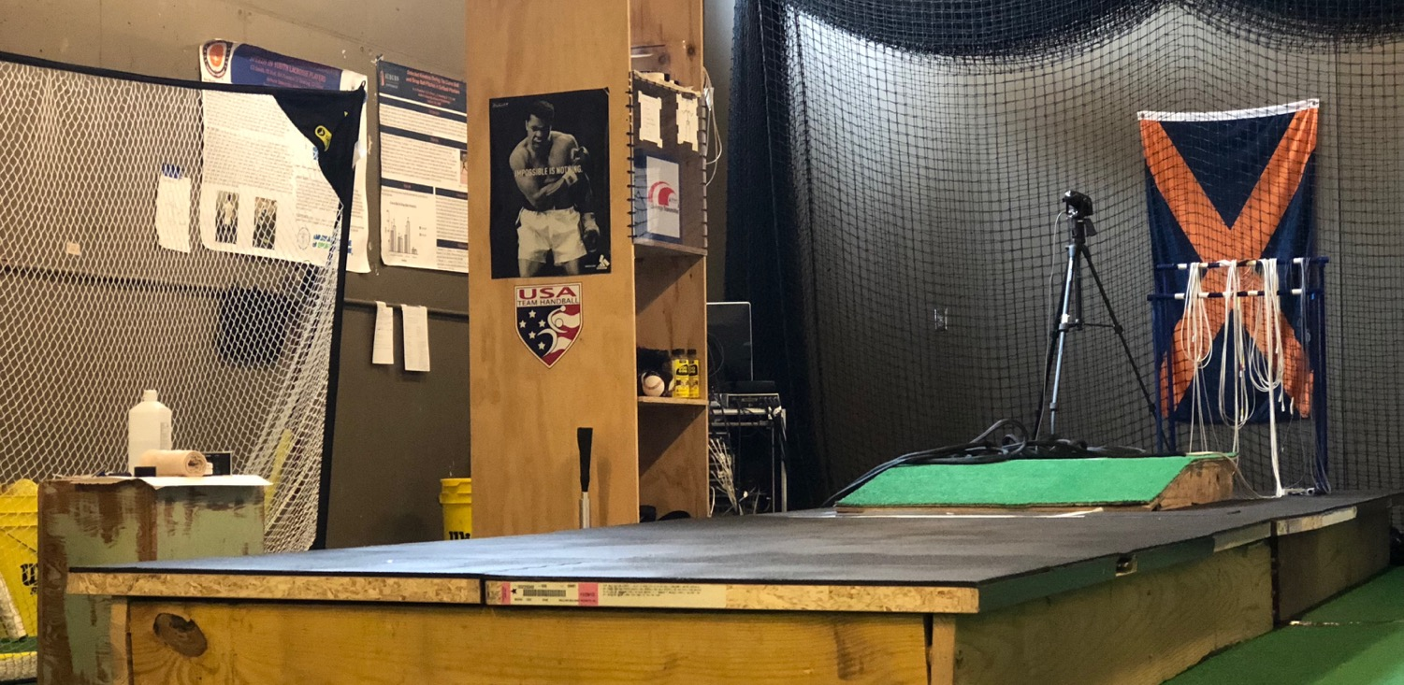


Humeral Segment Energy and its Relationship to Clinical Glenohumeral Measures in Youth Baseball Pitchers
Kyle Wasserberger, Jessica Downs, Kevin Giordano, Gretchen Oliver
Sports Medicine and Movement Laboratory; Auburn University
2020 SEACSM Annual Conference

Slide 2
Clinical Evaluation
Biomechanical Evaluation
Player Evaluation
Mobility/Stability
Strength/Power
Movement screens
Kinematics
Kinetics
Energetics

Slide 3
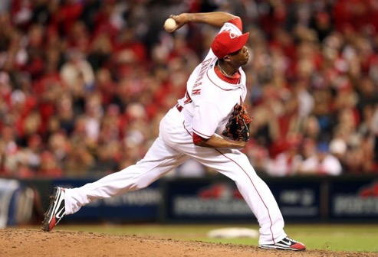
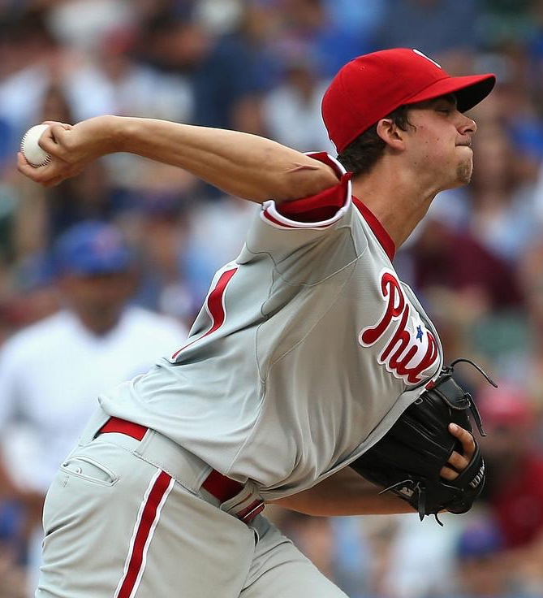

Glenohumeral Mobility/Stability
Notes:
Baseball pitchers at risk of shoulder injury
Large joint loads, excessive workloads, and inadequate rest periods¹
Glenohumeral (GH) joint
Undergoes extreme range of motion (ROM)
Requires large stabilizing forces from surrounding musculature^{2,5}
Clinical GH assessment
Loss of clinical strength and/or ROM = increased injury risk^{4,7-9}

Slide 4
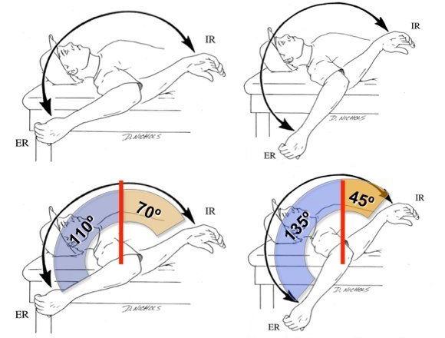
Mike Reinold.com

Slide 5
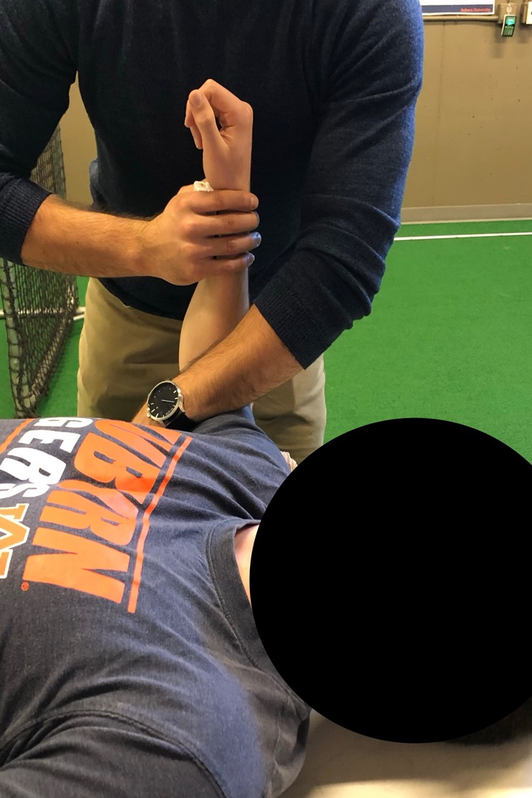
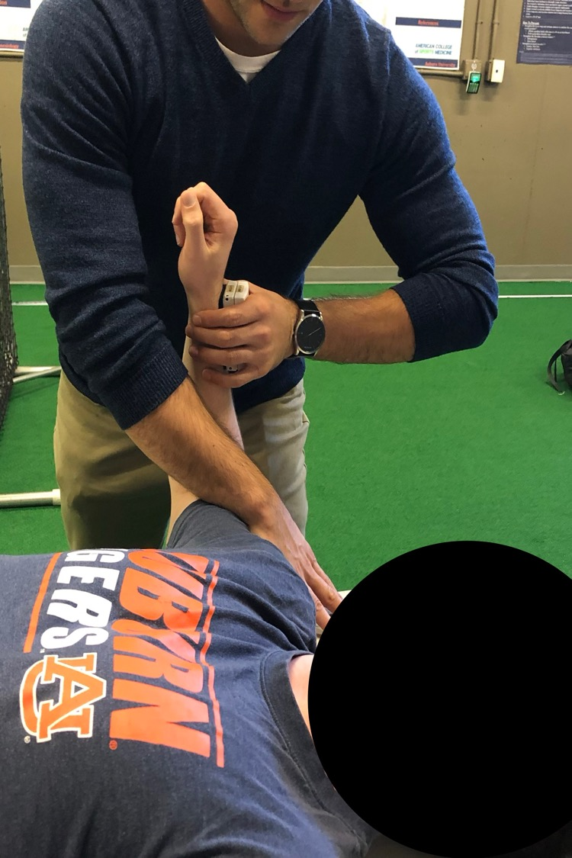
IR +
ER -

Slide 6
Clinical Evaluation
Biomechanical Evaluation
Player Evaluation
Mobility/Stability
Strength/Power
Movement screens
Kinematics
Kinetics
Energetics

Slide 7
Kinetic Chain & Energy Flow

Slide 8
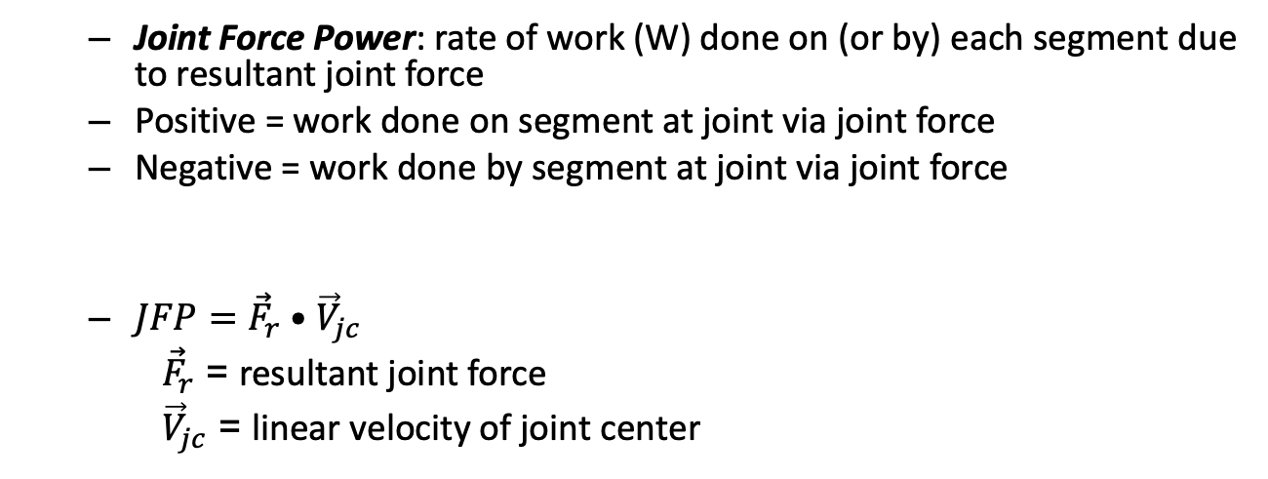
Energy Flow Terms and Definitions
Joint Force Power: rate of work (W) done on (or by) each segment due to resultant joint force
Positive = work done on segment at joint via joint force
Negative = work done by segment at joint via joint force
$JFP={\vec{F}}_{r}•{\vec{V}}_{jc}$
${\vec{F}}_{r}$ = resultant joint force
${\vec{V}}_{jc}$ = linear velocity of joint center
Notes:
Guo et al (2003) also called this translational joint power

Slide 9
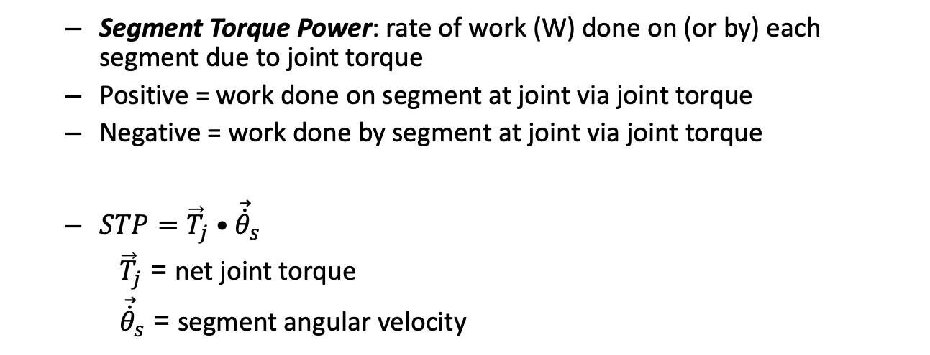
Energy Flow Terms and Definitions (cont.)
Segment Torque Power: rate of work (W) done on (or by) each segment due to joint torque
Positive = work done on segment at joint via joint torque
Negative = work done by segment at joint via joint torque
$STP={\vec{T}}_{j}•{\vec{\dot{θ}}}_{s}$
${\vec{T}}_{j}$ = net joint torque
${\vec{\dot{θ}}}_{s}$ = segment angular velocity
Notes:
Guo et al (2003) also called this rotational joint power

Slide 10

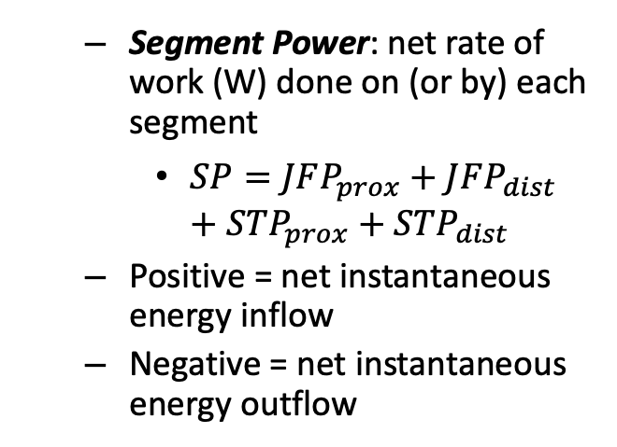
Energy Flow Terms and Definitions (cont.)
Segment Power: net rate of work (W) done on (or by) each segment
$SP=JFP_{prox}+JFP_{dist}+STP_{prox}+STP_{dist}$
Positive = net instantaneous energy inflow
Negative = net instantaneous energy outflow
+
-

Slide 11
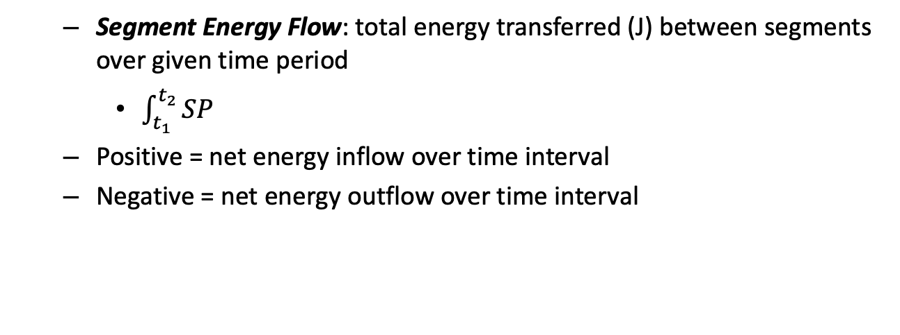
Energy Flow Terms and Definitions (cont.)
Segment Energy Flow: total energy transferred (J) between segments over given time period
$\int_{t_{1}}^{t_{2}}{SP}$
Positive = net energy inflow over time interval
Negative = net energy outflow over time interval

Slide 12
Question, Purpose, Hypothesis
Do clinical injury predictors relate to energy flow?
What is the intersection between clinical evaluation and biomechanical evaluation
Value of throwing shoulder clinical assessment?
Hypothesis = increased strength and/or ROM will be associated with decreased amount of mechanical energy transfer needed to obtain a given level of performance (pitch speed)

Slide 13
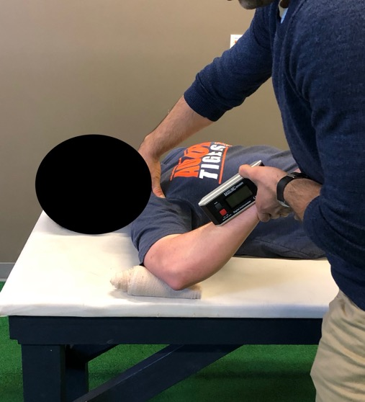
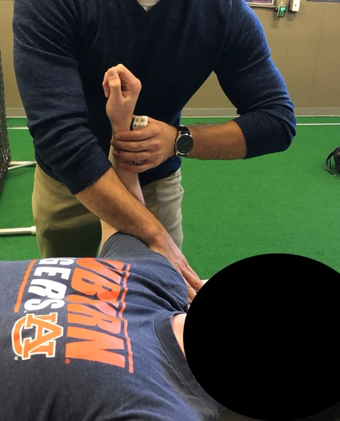
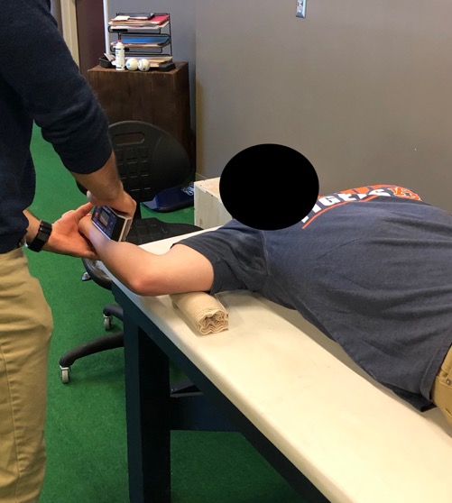
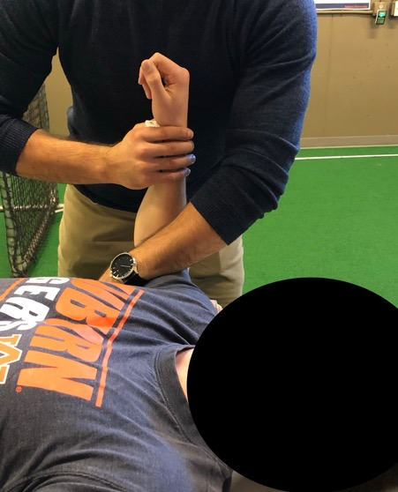
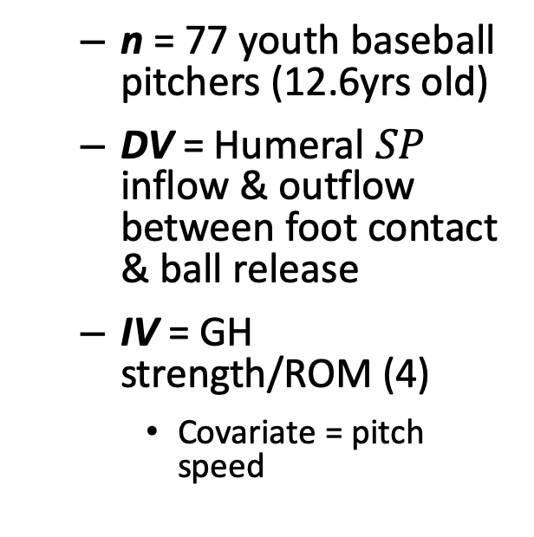
Study Methods
n = 77 youth baseball pitchers (12.6yrs old)
DV = Humeral $SP$ inflow & outflow between foot contact & ball release
IV = GH strength/ROM (4)
Covariate = pitch speed

Slide 14
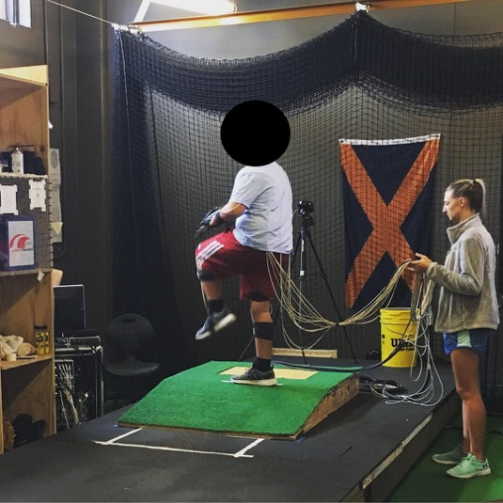
Study Methods (cont.)
Averaged data over 3 valid trials
Hierarchical linear regression (2; )
p = 0.025 a priori

Slide 15
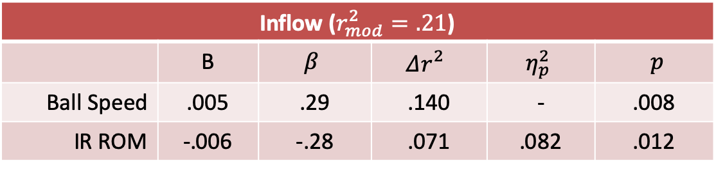
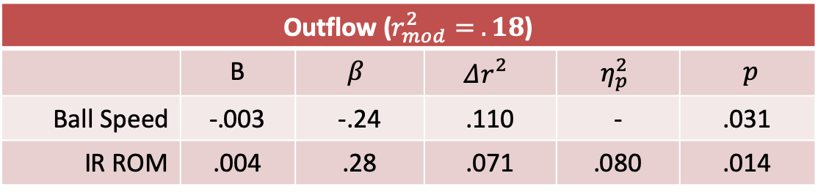
IR ROM negatively predicted humeral energy inflow & outflow
Inflow ($r_{mod}^{2}=.21$)
 | B | $$β$$ | $$Δr_{}^{2}$$ | $$η_{p}^{2}$$ | $p$
Ball Speed | .005 | .29 | .140 | - | .008
IR ROM | -.006 | -.28 | .071 | .082 | .012
Outflow ($r_{mod}^{2}= .18$)
 | B | $$β$$ | $$Δr_{}^{2}$$ | $$η_{p}^{2}$$ | $p$
Ball Speed | -.003 | -.24 | .110 | - | .031
IR ROM | .004 | .28 | .071 | .080 | .014

Slide 17
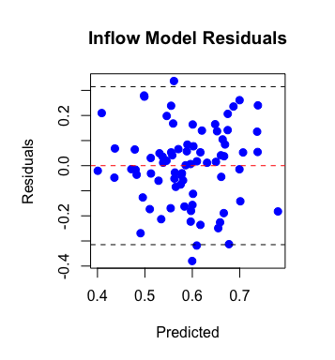
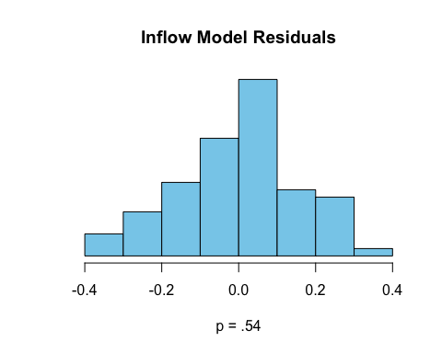
Inflow Model Diagnostics

Slide 19
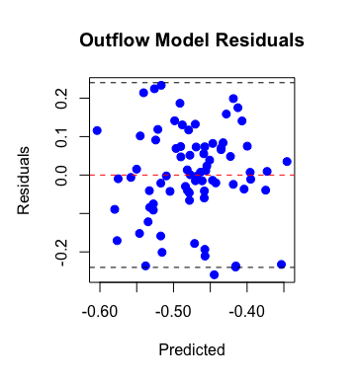
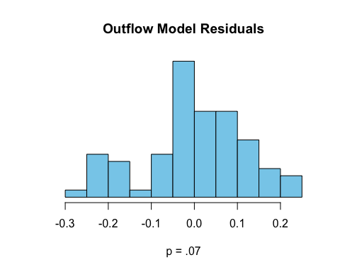
Outflow Model Diagnostics

Slide 20
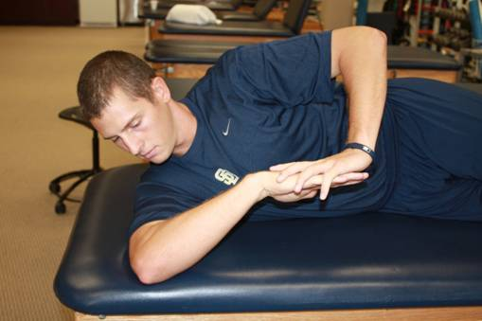
Discussion
Models showed limited ability to predict humeral energy flow
↑ energy flow with ↓ IR ROM
Orthobullets.com

Slide 21
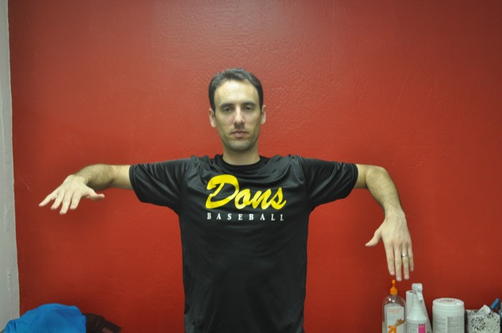
Discussion
Previous research associates IR loss (GIRD) with shoulder injury^{3,7-9}
Could ↑ energy transfer be (partially) responsible?
Balance between ↑ pitch velocity and ↑ energy flow
Peakformhealthcenter.com

Slide 22
Future Directions
Go bigger: Examine whole kinetic chain
Go smaller: Isolate shoulder and elbow
Do results hold in older/better pitchers?
Softball pitchers?
Non-normalized energy terms
Differences in energy generation/transfer between bigger/smaller pitchers of similar ability

Slide 23
Sources
Agresta (2019). Risk Factors for Baseball-Related Arm Injuries: A Systematic Review. Orthopaedic Journal of Sports Medicine.
Buffi (2015). Computing Muscle, Ligament, and Osseous Contributions to the Elbow Varus Moment during Baseball Pitching. Annals of Biomedical Engineering.
Bullock (2018). Shoulder Range of Motion and Baseball Arm Injuries: A Systematic Review and Meta-Analysis. Journal of Athletic Training.
Byram (2010). Preseason Shoulder Strength Measurements in Professional Baseball Pitchers: Identifying Players at Risk for Injury. American Journal of Sports Medicine.
Digiovine (1992). An Electromyographic Analysis of the Upper Extremity in Pitching. Journal of Shoulder and Elbow Surgery.
Howenstein (2019). Energy Flow Analysis to Investigate Youth Pitching Velocity and Efficiency. Medicine & Science in Sports & Exercise.
Trakis (2008). Muscle Strength and Range of Motion in Adolescent Pitchers with Throwing-Related Pain: Implications for Injury Prevention. American Journal of Sports Medicine.
Lin (2018). Shoulder Injuries in the Overhead-Throwing Athlete: Epidemiology, Mechanisms of Injury, and Imaging Findings. Radiology.
Wilk (2015). Deficits in Glenohumeral Range of Motion Increase Risk of Shoulder Injury in Professional Baseball Pitchers: A Prospective Study. American Journal of Sports Medicine.

Slide 24




Thank you! Questions?
github.com/wasserberger-kyle/
sportsmedicineandmovementau.com

